Slide 1
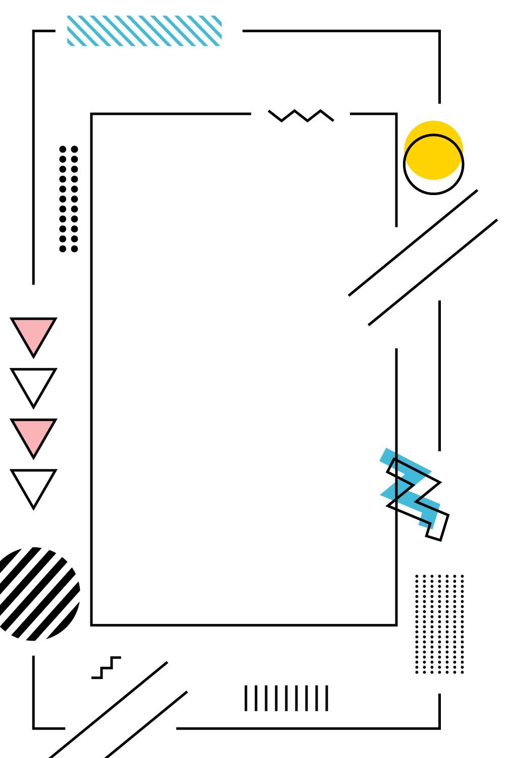
SOFTWARE PROJECT LAB-1
Project Submission Presentation
K
K E Y T Y P E
Type Like a Pro

Slide 2

INTRODUCTION
KeyType is a console based ultimate typing game that will put your typing skills to the test. Featuring a dynamic word bank, KeyType is not just a game - it's a journey towards keyboard mastery.

Slide 3
OBJECTIVES
Enhance Typing Accuracy
Improve Typing Speed
Boost Focus and Concentration
Language Proficiency

Slide 4
INTERFACE
WELCOME
MESSAGE
GAME
BOARD
GAME
OVER

Slide 5
KEY FUNCTION
Pseudo Random
File Handling

Slide 6
FEATURE
RIGHT WORD
WRONG WORD
PAUSE
SCORE
NEW WORD
RESUME

Slide 7
CHALLENGES
IMPLEMENTATION OF PAUSE RESUME
DISPLAYING WORD RANDOMLY
FALLING DOWN WORD
GAME OVER AFTER TOUCHING BOTTOM WALL

Slide 8
PROGRAMING CONCEPTS
CONSTRUCTOR
CALL BY
VALUE
CALL BY
REFERENCE

Slide 9



STAKEHOLDERS
Computer Operator
Programmer
Student

Slide 10
DELIVERIES
SOURCE CODE
DOCUMENTS
JAR FILE

Slide 11

ANY
QUESTION ?

Slide 12


